Slide 1

Presentation Team Project
Subject: Mobile and web application for sells and buys products
Realized By: Sprint Squad Team

Slide 2

Plan

Slide 3

Introduction
Preliminary study
Analysis and Design
Implementation
Conclusion
Deployment

Slide 4

Introduction

Slide 5

Introducing our Web and Mobile Marketplace SwapShop for easy, secure, and diverse shopping.
Explore a world of products, navigate effortlessly, and enjoy hassle-free transactions. Experience online shopping redefined, combining convenience, reliability, and endless choices. Step into the future of digital commerce with our user-friendly app.

Slide 6
Preliminary study

Slide 7

Existing criticism
The absence of a dedicated delivery features
Insufficent security measures .
The absence of shipment tracking functionality.

Slide 8

Our Solution

Slide 9

* introducing a comprehensive solution suite * advanced shipment tracking features * monitor deliveries in real-time * enhancing transparency and overall user experience * ensures a more robust and user-friendly marketplace environment

Slide 10

Sprints planification

Slide 11
Sprint 1: Initialization Project, category and product’s seller Crud.
Sprint 2: Crud’s products in customer’s Wishlist ,pass orders and tracking shipement.
Sprint 3: Authentication Reviewing, badges system, user’s statics And Notification.

Slide 12

Analysis And Design

Slide 13

Sprint 1

Slide 14
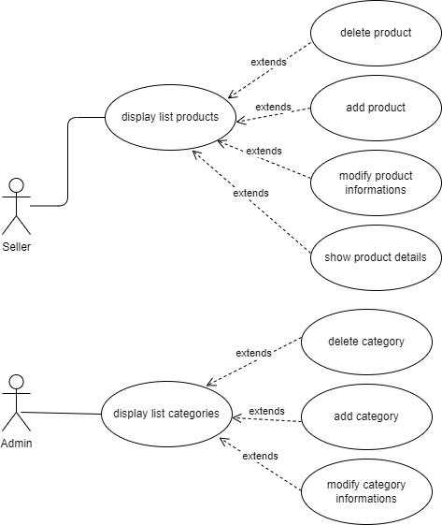

Slide 15
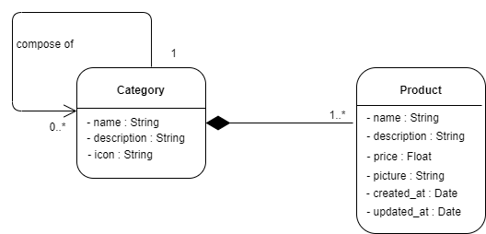

Slide 16
Sprint 2

Slide 17
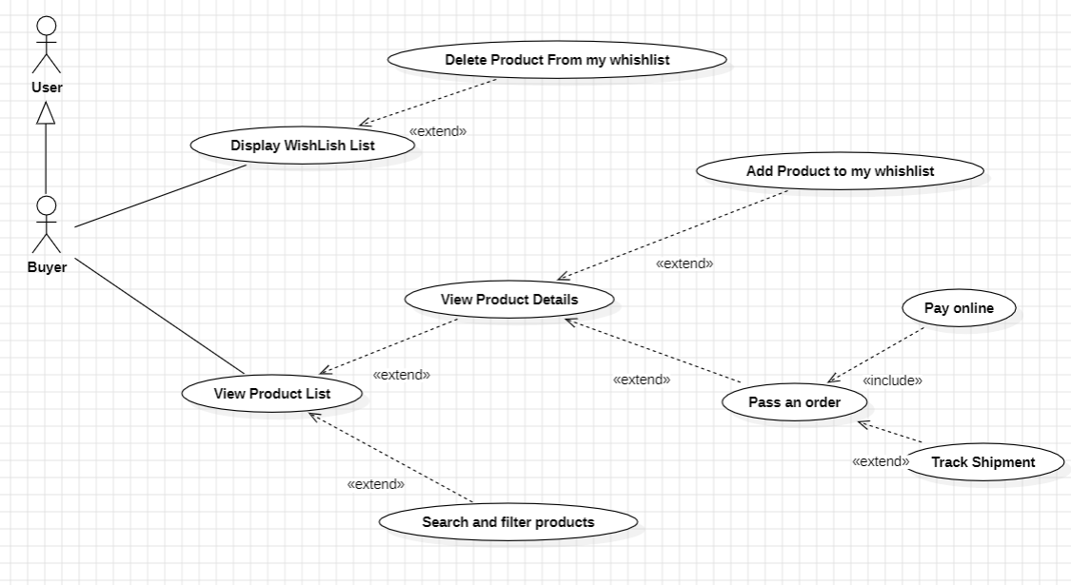

Slide 18
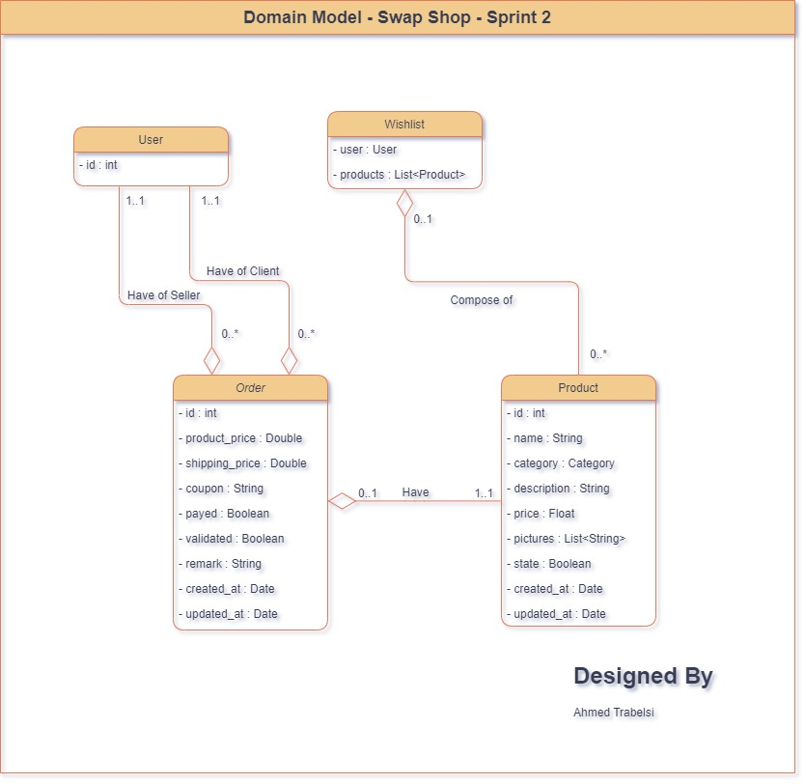

Slide 19
Sprint 3

Slide 20
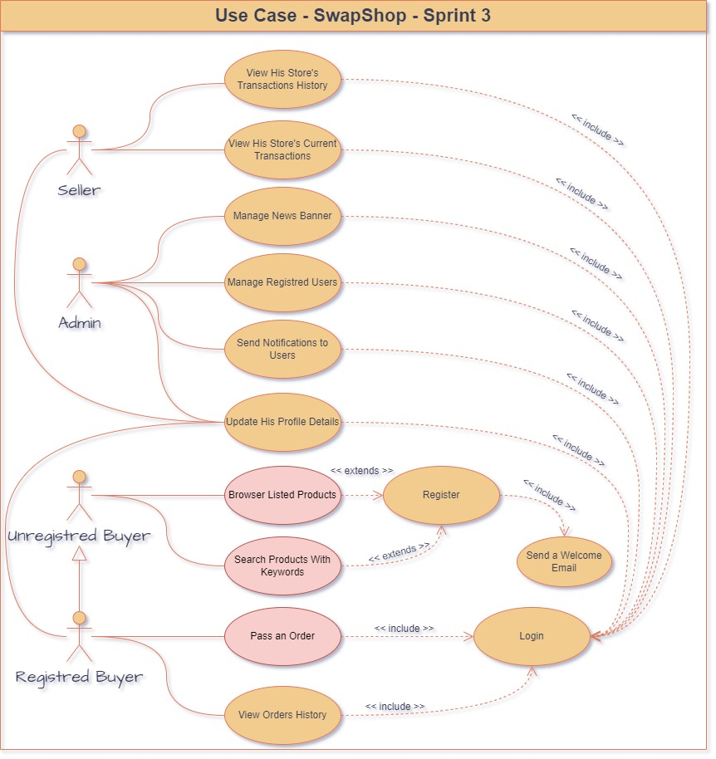

Slide 21
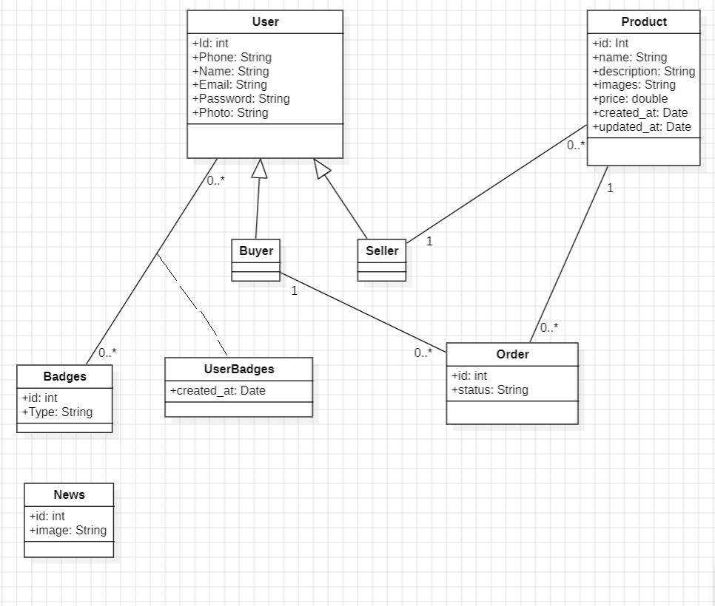

Slide 22

Implementation

Slide 23

Software environments

Slide 24








Slide 25
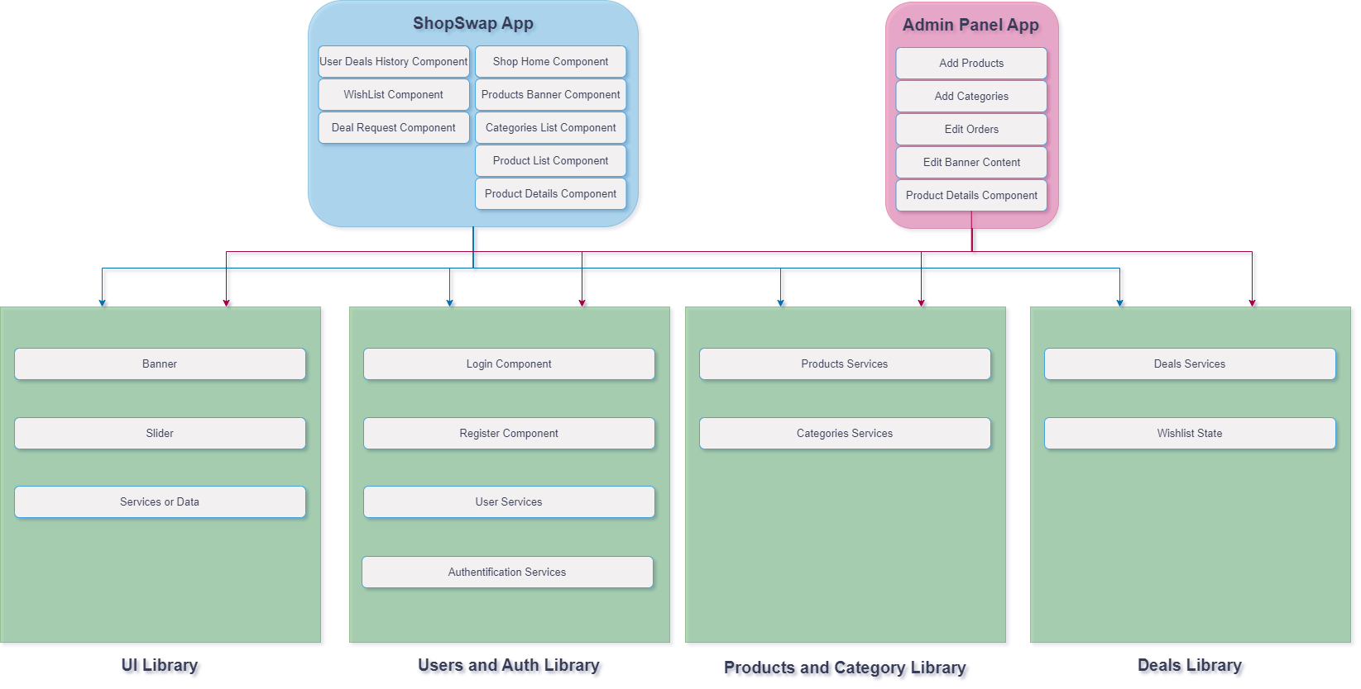
NX – Angular Project Structure

Slide 26
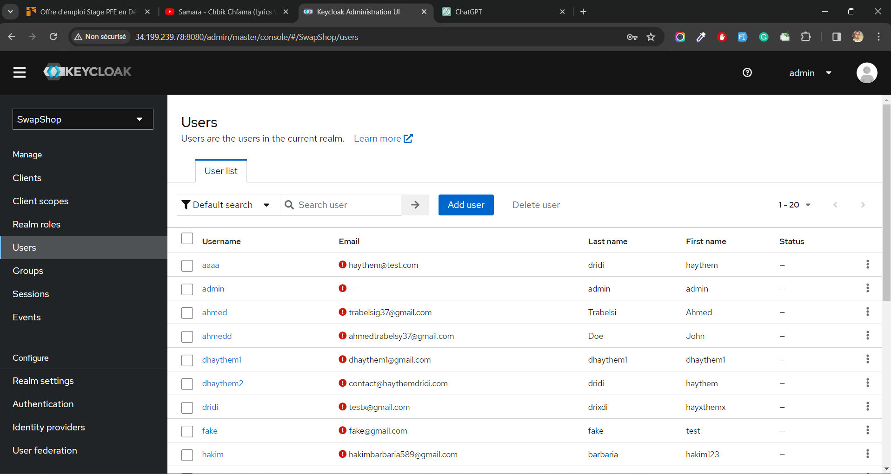
Keycloack

Slide 27


Keycloack
Secured authentication service:
Keyloack support secure authentication methods with o Auth2 protocol
Easy User Management: Keycloak provides a centralized user management system, simplifying the administration of user accounts. Easy Role Management : Users can be assigned roles, and access permissions can be granted based on these roles, enhancing security and manageability.
High Availability: It offers features for creating high-availability configurations, ensuring continuous service availability

Slide 28

Docker
Ensures Team Unity:
Allows us to ensure that all team members work in the same
environment, avoiding versioning and compatibility issues.
Simplifies Microservices Execution: Enables the execution
of all microservices with a single command,
streamlining the process of development compared to launching
each microservice individually. Efficient Server Deployment: Allows the execution of
microservices on servers with a single command,
simplifying the deployment process

Slide 29
Sprint 1

Slide 30
Sprint Goals
Implement products management functionality.
Implement a category management functionality

Slide 31
Sprint Review
Accomplishments in this sprint include the successful implementation of a user-friendly system for managing purchased products and the integration of a category management system, enhancing overall user control and organization within the application

Slide 32
Sprint Retrospective
What’s going well | Going to ameliorate
Technical developpement | Time estimation for tasks
 | Affecting tasks to member

Slide 33
Sprint 2

Slide 34
Sprint Goals
Enable CRUD operations for products in the customer's Wishlist, enhancing user customization.
Implement order processing functionality for seamless and efficient transactions.
Integrate shipment tracking features to provide real-time visibility into order status, enhancing transparency for users.

Slide 35
Sprint Review
Accomplishments include enabling CRUD operations for customer Wishlist customization, implementing seamless order processing, and integrating real-time shipment tracking for enhanced user transparency. These advancements contribute to an improved overall user experience.

Slide 36
Sprint Retrospective
What’s going well | Doing to ameliorate
Technical developpement | Affecting tasks to members
Time estimation for tasks | Doing a daily recap for what we did

Slide 37
Sprint 3

Slide 38
Sprint Goals
Strengthen authentication protocols for enhanced user security
Introduce a badges system to recognize user achievements and boost engagement.
Implement a user statistics feature for valuable insights into user behavior.
Develop a comprehensive notification system to keep users informed and engaged with platform activities.

Slide 39
Sprint Review
Achievements include strengthened authentication for enhanced security, a new badges system for user recognition and engagement, user statistics implementation for valuable insights, and the development of a comprehensive notification system to keep users engaged with platform activities. These advancements collectively enhance the user experience and platform functionality.

Slide 40
Sprint Retrospective
What’s going well | Doing to ameliorate
Technical developpement | Ameliorate our communications skills
Time estimation for tasks

Slide 41

deployment

Slide 42

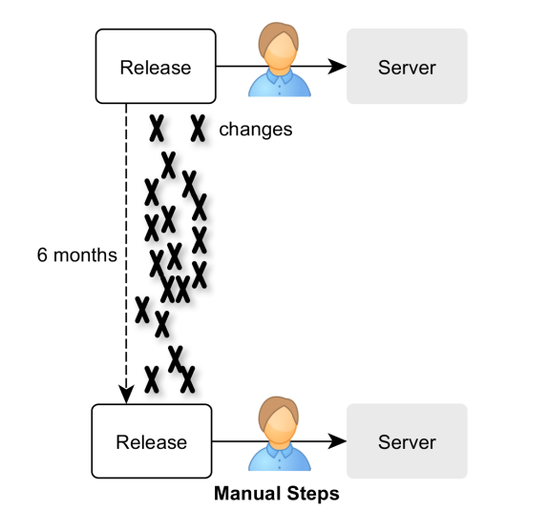

Delivery’s old process
Shutdown – Lose of time and customers
infrastructure setup and updating
Manual Deployment and deployment
increase possibilities of
compatibility and version errors.

Slide 43
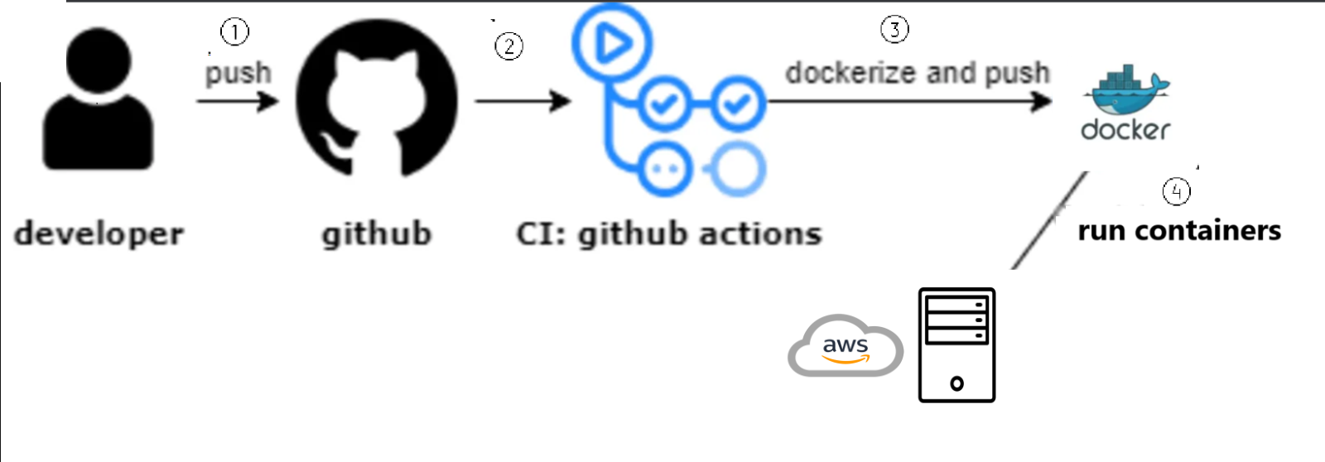
Delivery PROPOSED process

Slide 44
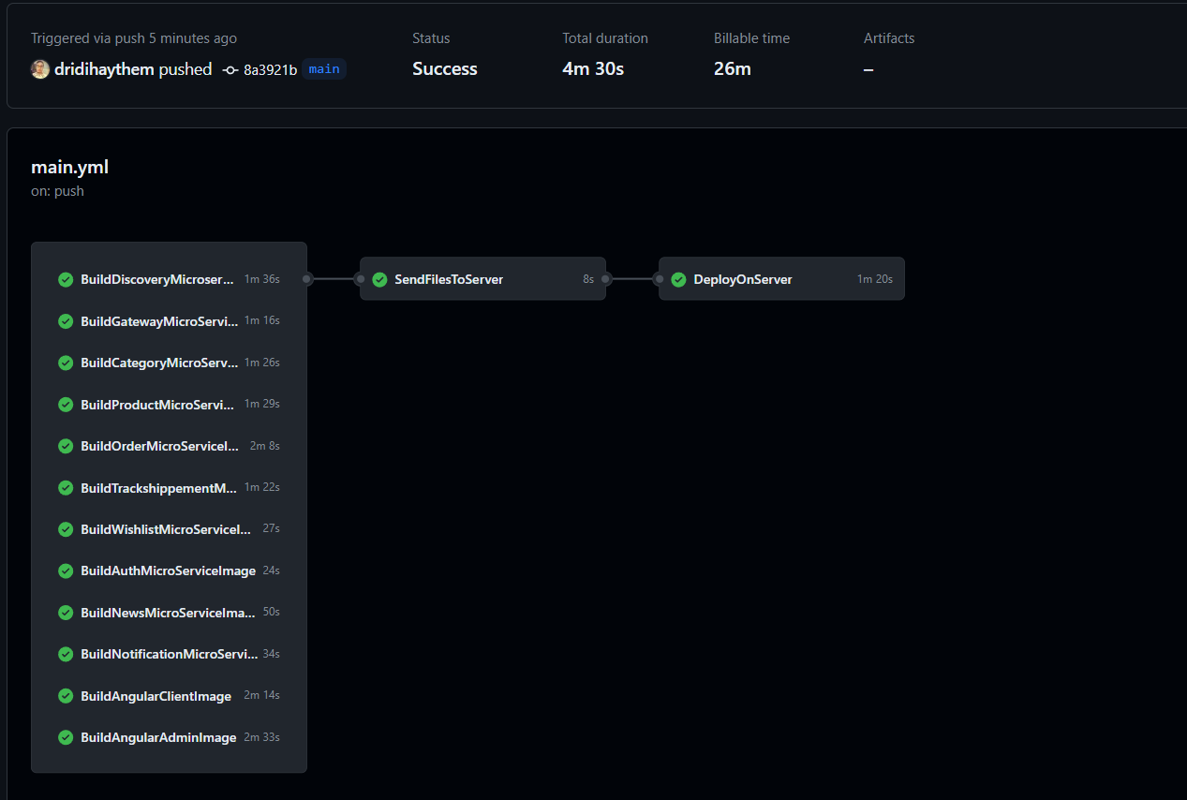
This Job is running a docker command to build the dockers images and push them to docker hub

Slide 45
This Job is sending the configuration files to the server (passwords..)

Slide 46
This job will run the container ensure a fully functional system

Slide 47
The full steps of the pipleline

Slide 48
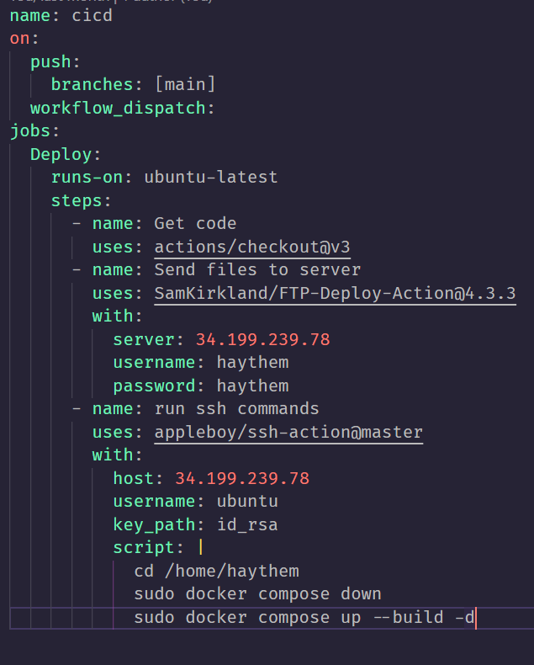
Github actions
This pipline ensure the continus delivery after merge the work in the main branch , this pipline will:
Connect to server to upload the changed code
Run a docker command to build the dockers images and run containers

Slide 49
Advantages of this pipline :
Instant Deployment:
The process ensures that all modifications are deployed immediately on the servers, ensuring that users can view the changes without delay.
Automated Deployment: The system automatically deploys all changes without the need for human intervention, streamlining the deployment workflow.
Docker Integration: By leveraging Docker, we guarantee
that code tested and functioning locally will seamlessly
work in the production environment.
This eliminates any errors related to compatibility or
versioning issues.

Slide 50
Conclusion

Slide 51
Looking ahead, the groundwork laid during these presentations sets the stage for continuous growth and refinement. The collaborative spirit of the team positions us for ongoing success, and we anticipate a future marked by even greater advancements, ensuring our platform remains at the forefront of user satisfaction and technological excellence.

Slide 52
Thanks for your attention happy swapping ☺

